Slide 1
Building multilayer neural networks using TensorFlow's Layers API
2024/6/21
Liu zhiyuan
Interdisciplinary Graduate School of Engineering Sciences (I-EggS)
Kyushu University

Slide 2
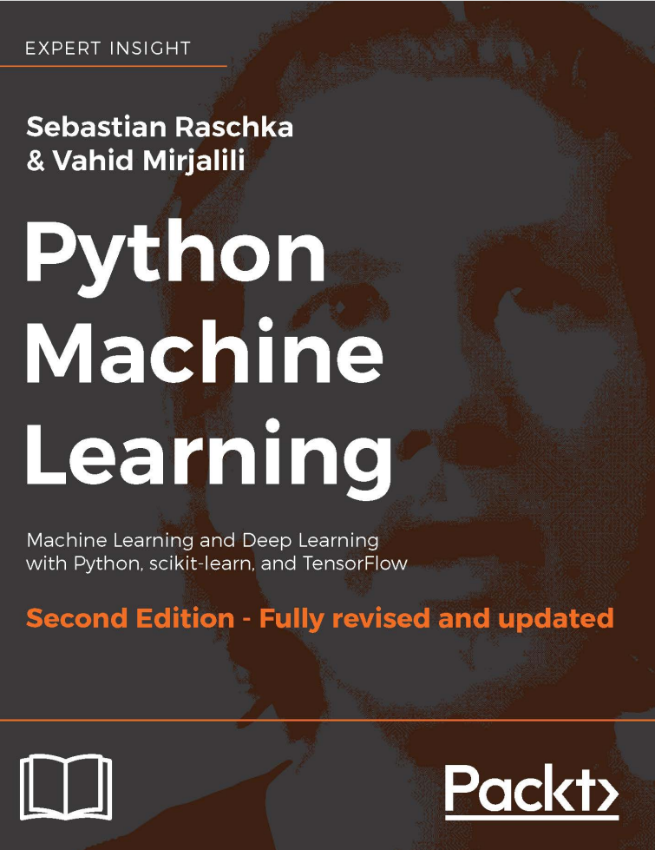
Table of contents
What is MNIST dataset
How to read and process data from dataset
How to build a model
How to train and test your model
Notes:
I am very pleased to be here today to share with you the knowledge I have gained about TensorFlow. I have been assigned to cover pages 434 to 438 of the book, which provides an example of training a model using the MNIST dataset. However, since the book does not cover any details or implementation principles and only mentions the model training process, I would like to expand on the content of my presentation today. I will start by explaining what the MNIST dataset is and then guide you through how to build, train, and test a neural network model.
非常高兴今天能坐在这里为大家分享我所掌握的有关tensorflow的知识，我被分配到的章节是434页至438页，书中举了一个使用MNIST数据集训练模型的例子。但由于书中没有讲到任何的细节和实现的原理，只提到了模型训练的过程，今天我想扩充一下发表的内容，从什么是MNIST数据集开始，告诉大家如何搭建、训练并完成测试一个神经网络模型。

Slide 3

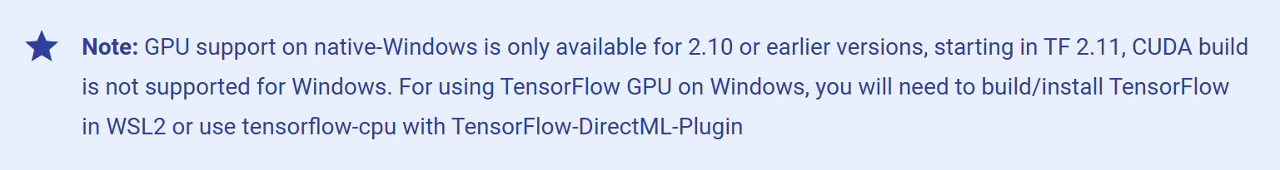
First thing first
GPU support on Windows system
Tensorflow has announced that it is stopping support for GPU acceleration on the windows, which means that from version 2.10 onwards, only basic cpu computing will be available for the windows system
Notes:
Before I officially begin my presentation, I want to inform you of something very important. TensorFlow, starting from version 2.10, has discontinued support for GPU on the Windows platform and has merged tensorflow-gpu and tensorflow-cpu into a single package called tensorflow. Therefore, from version 2.10 onward, you will not be able to use GPU acceleration on the Windows platform. If you want to use hardware acceleration with versions after 2.10, you will either need to create a Linux environment using a virtual machine or use a Docker container to set up the runtime environment.
在我的发表正式开始之前，我想要先告知诸位一件非常重要的事，Tensorflow自从2.10开始取消了对windows平台gpu的支持，并且将tesnsorflow-gpu和cpu合并为tensorflow，所以从2.10版本之后你将无法再windows平台使用gpu加速。如果你想在2.10的版本后使用硬件加速，要么使用虚拟机创建linux环境要么使用docker容器来创造运行环境

Slide 4
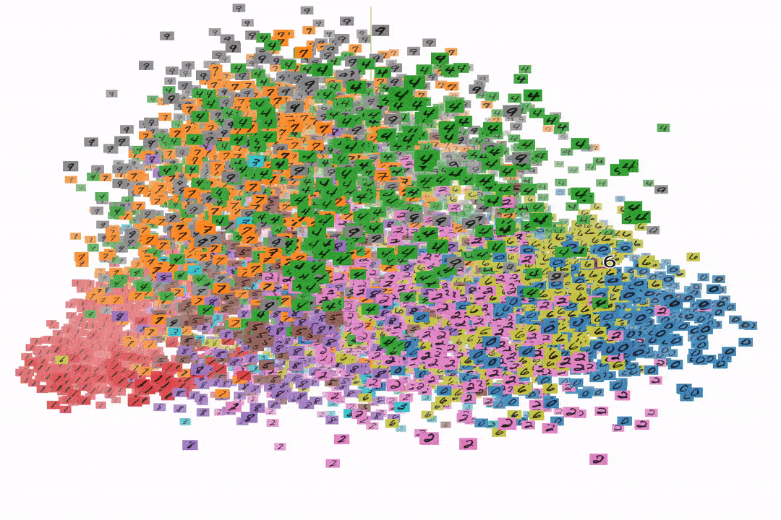
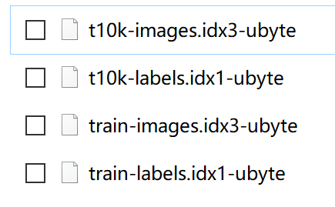
1. What is MNIST
one sample for MNIST data formation
MNIST dataset
70000 images in total
10000 images for test
60000 images for training
YOU CAN GET THIS DATASET AT: http://yann.lecun.com/exdb/mnist/
Notes:
Next, I would like to introduce the dataset we will be using today. You can access it from the address displayed at the bottom of the screen, or you can download a pre-packaged version from my GitHub. The GitHub link I shared contains all the programs we will use today. You can try running each script as I explain them; each has its own function and can run independently.
As you can see, the dataset consists of four files. The top two are for testing, containing 10,000 images and labels, and the bottom two are for training, containing 60,000 images and labels. I used TensorFlow's official dataset visualization tool to perform a principal component analysis on the entire dataset, reducing it to three dimensions, and created the GIF image shown on the left. Each color represents a label, that is, a class of digits. You can clearly see their aggregation trend in the three-dimensional plane, which mathematically demonstrates the feasibility of using neural networks for image classification.
接下来我想先为大家介绍一下我们今天用到的数据集，你可以从屏幕下方的地址来获取它，或者直接从我的github下载已经打包好的版本，我分享的github连接里包含了今天所用到的全部程序，你可以在我讲解的时候尝试运行每一个脚本，它们每一个都有各自的作用并且可以独立运行。如你所见，数据集包含四个文件，其中上面两个是用来测试的10000张图片和标签，下面两个是用来训练的60000张图片和标签。我使用tensorflow的官方数据集可视化软件对整个数据集进行了主成分分析并将其降至了三维并制成了左边的gif图。每一个颜色代表一个标签，即一类数字，你可以清楚的看到他们在三维平面上呈现了聚合趋势，这也从数学角度证明了为什么神经网络进行图像分类的可行性。

Slide 5
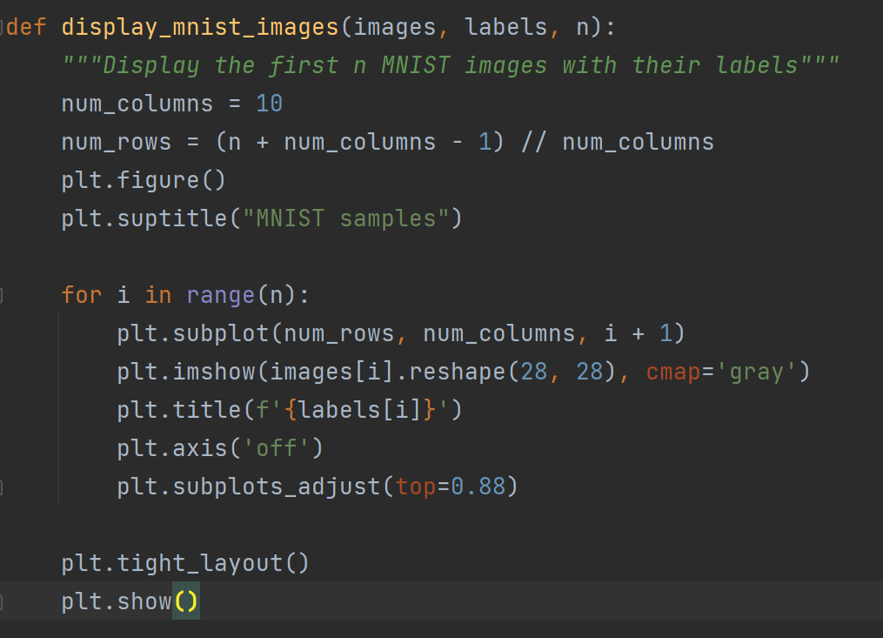
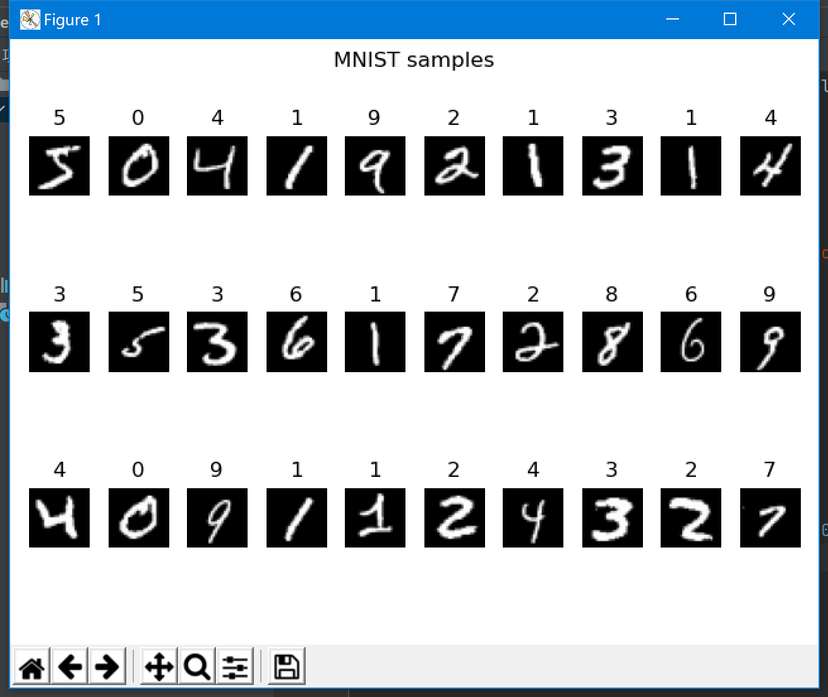
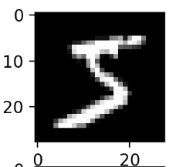
1. What is MNIST
Visualizing a dataset using data.py
Unpack
Data
28x28 pixels
Gray value
Notes:
The analysis I mentioned earlier is quite macroscopic, so let's observe this dataset from a more microscopic perspective. Now, you can run the data.py script I provided. It will show you what the dataset looks like once unpacked. In fact, what the neural network receives is a 28x28 image. These images are handwritten digits, half collected from high school students and the other half from the National Institute of Standards and Technology (NIST).
Here, I would like to introduce another concept: grayscale. Grayscale is a value between 0 and 255 used to describe how white a pixel in an image is. If a pixel's value is pure white, its grayscale value is 255; conversely, if a pixel is pure black, its grayscale value is 0. By converting an image to a grayscale image, the information is compressed into a single dimension, which can then be read and processed by a computer.
我上面讲到的分析过于的宏观，我们可以从更加微观的角度观察这个数据集，现在你可以运行我提供程序的data.py脚本，它将向你展示这些数据集解包后的样子，实际上神经网络接受的正是这样一个有一个28x28的图像，这些图片都是人类的手写数字，一半采集自高中生另一半采集自美国国家标准与技术研究所。在这里我想介绍另一个概念，即灰度。灰度是一个0-255的值用来描述图像中的一个像素到底有多么的白，如果一个像素的值是纯白，那么它的灰度就是255，相反的如果一个像素是纯黑的，那么它的灰度则为0，通过将图像转换为灰度图，信息被压缩至一维，可以被计算机进行读取并处理。

Slide 6
2.How to read and process data from dataset
def load_mnist(path, kind='train'): """Load MNIST data from `path`""" labels_path = os.path.join(path, '%s-labels.idx1-ubyte' % kind) images_path = os.path.join(path, '%s-images.idx3-ubyte' % kind) with open(labels_path, 'rb') as lbpath: magic, n = struct.unpack('>II', lbpath.read(8)) labels = np.fromfile(lbpath, dtype=np.uint8) with open(images_path, 'rb') as imgpath: magic, num, rows, cols = struct.unpack(">IIII", imgpath.read(16)) images = np.fromfile(imgpath, dtype=np.uint8).reshape(len(labels), 784) # # for test # cv2.imshow('', images[0, :].reshape(28, 28)) images = ((images / 255.) - .5) * 2 return images, labels
Step1:Unpack the dataset and read the images and tags respectively
Step2:Use numpy to flatten the 28x28 image to 1x784.
Step3: images = ((images / 255.) - .5) * 2 maps the grayscale data from 0-255 in the image to the interval -1 to 1
Data after mapping(slice[152:159])
Shape(1, 784)
Notes:
Now, let's move on to the part where we load the dataset. Common types of datasets include text data, image data, and audio data. The MNIST dataset falls into the category of image data. We first use NumPy to read the data from the dataset, flatten it into one dimension, and then map it to a range between -1 and 1. This last mapping step is crucial because it scales the values of the data to a very small range without losing information, which helps the model converge and provides a uniform standard for the dataset, reducing the impact of variations in brightness on the model.
Additionally, I have removed the regularization processing that was originally included in the book. The reason is simple: although the provided regularization helps with model training (which is indeed the focus of this chapter), it is not beneficial for model prediction. Since normalization has already been performed, regularization has little impact. Based on this consideration, I have commented out the code. If you are curious about its original function, you can uncomment it to see its effect.
现在让我们来到加载数据集的部分，常见的数据集类型有：文本数据、图像数据和音频数据，MNIST属于图像数据的范畴，我们先通过numpy将数据从数据集中读取出来，将其展平为一维，最后映射到-1至1之间，最后这一步映射十分关键，映射后的数据在不损失信息的情况下将数据的值缩放到一个很小的尺度，有利于模型的收敛，同时也为数据集提供了一个统一的标准，减少明暗变化对模型的影响。另外有一点，我移除了书中原有的正则化处理，原因很简单，其给出的正则化处理虽然有利与模型的训练（当然这也是本章的主题）却不利于模型的预测，因为已经进行了归一化所以是否正则影响不大，基于这点考虑我将代码做了注释化处理，如果你好奇它原本的功能，可以取消注释化来看看它原本起到的作用。

Slide 7
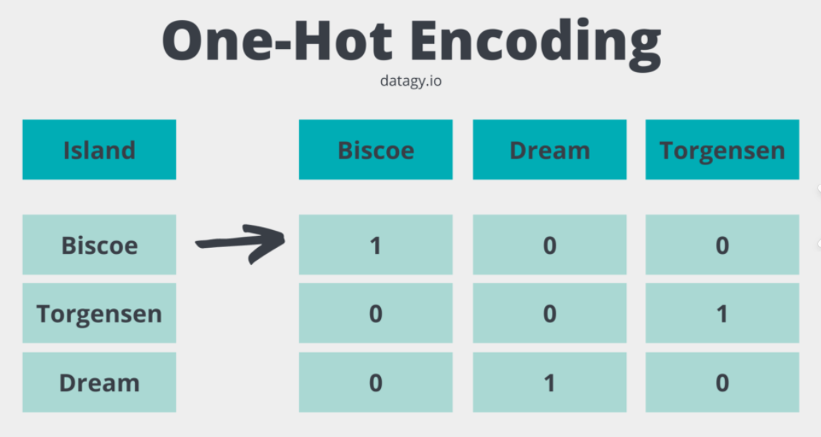
2.How to read and process data from dataset
Batch generator
One-hot encoding
def create_batch_generator(x, y, batch_size=128, shuffle=False): x_copy = np.array(x) y_copy = np.array(y) if shuffle: data = np.column_stack((x_copy, y_copy)) np.random.shuffle(data) x_copy = data[:, :-1] y_copy = data[:, -1].astype(int) y_one_hot = tf.one_hot(y_copy, 10) for i in range(0, x.shape[0], batch_size): yield x_copy[i:i + batch_size, :], y_one_hot[i:i + batch_size, :]
We use 1 for yes to the category and 0 for no, which you can also interpret as the probability that ideally the apple is one hundred percent apple zero percent something else.
Notes:
After discussing data reading, let's talk about data processing. The amount of data read is substantial, with 60,000x784 entries. We typically divide this data into different batches for input into the model for training. In simple terms, we split the data into smaller parts to feed into the model, updating the gradient after each batch is trained. This approach reduces memory consumption and accelerates model convergence. Another potential benefit is that batch training facilitates parallel computation, significantly speeding up training for large models.
We can conduct an interesting experiment by changing the batch_size to 1, which will result in an extremely slow training process. This is due to TensorFlow's characteristics. Since TensorFlow's core code is written in C++, each time data is fed into the model, the Python thread must communicate with the TensorFlow C++ thread, leading to very low efficiency. Therefore, when building a model, it's essential to minimize data reads and exchanges to speed up training, within the limits of available memory.
This code also introduces another key concept: one-hot encoding. This is a label encoding format where the class is represented by a 1, and all other columns are 0. By using this method, we inform the model about the training target and the difference between the current model state and the ideal state.
说完了数据集的读取，我们来讲数据集的处理。读取完的数据量非常的大，足足有60000x784，我们通常会将其分为不同的batch来输入模型进行训练，简单来说就是分成几个小部分来送入模型，每训练完一个batch就更新一次梯度，这样可以减少内存消耗并且加快模型收敛。还有一个潜在的好处，分batch训练更容易进行并行运算，在一些大型模型并行训练时可以极大的加快训练速度。我们可以做一个有趣的试验，把这里的batch_size改为1，你就会收获一个巨慢无比的训练过程，这是由于tensorflow的特性导致的，因为tensorflow的核心源码是c++写的，每次向模型输入数据都需要python线程与tensorflow的c++线程进行通信，导致运行效率极低，所以在构建模型的时候一定要在内存允许的情况下减少数据读取和交换的次数来加快训练的速度。
这段代码里还提到了另一个关键的概念，one_hot编码，这是一种标签编码格式，用1来表示类别，其余列均为0，通过这种方式我们告诉模型，模型的训练目标是什么，以及当前模型与理想状态的差是多少。

Slide 8

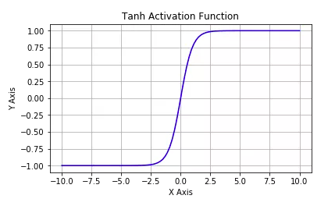
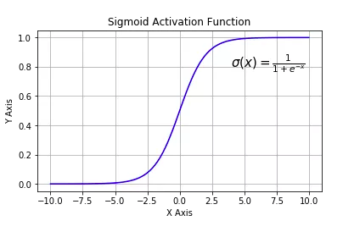
3.How to build a model
INPUT
def build_model(): my_model = tf.keras.Sequential([ layers.Dense(50, activation=tf.nn.tanh, name='layer1'), layers.Dense(50, activation=tf.nn.tanh, name='layer2'), layers.Dense(10, activation=tf.nn.softmax, name='logits') ]) return my_model
Dense1 tanh
Dense2 tanh
Dense3 softmax
Endow the network with nonlinear
OUTPUT
Notes:
This part is very short and easy to understand. In TensorFlow 2, there are three ways to build your model: using Sequential, building with the functional API, or inheriting from the Model base class. The first and third methods are the most commonly used. The book uses the second method, but it is neither easy to maintain nor understand and lacks the flexibility of the third method. Therefore, I will use the simplest and most understandable method, Sequential, to illustrate building a model.
Building a model is like building with Lego blocks. Similar to the book, we construct a very simple three-layer neural network for prediction, where all three layers are fully connected, but their number of nodes and activation functions differ. The activation function is also a crucial concept because, without it, the model would never converge. It can be said that activation functions give neural networks their power.
Let me describe how activation layers work in a simple way. Without activation functions, the output of our model would be merely a simple linear function, a first-degree polynomial. Nowadays, linear equations are easy to solve, but their complexity is limited, and their ability to learn complex function mappings from data is minimal. We want our neural networks to learn and compute not just linear functions but also much more complex functions to handle images, audio, and various types of information. Therefore, we need to add activation functions to increase the model's non-linearity, thus enhancing its ability to fit complex functions and improving its learning capability.
In this example, we use `tanh` and `softmax`. The `tanh` function is now rarely used because it is computationally intensive. If you replace `tanh` with `relu` here, the computation speed would be much faster. The other activation function, `softmax`, is very commonly used because it maps the results to a range between 0 and 1. Remember the part about one-hot encoding? We use 0 and 1 to represent probabilities. If we use `softmax` as the output of the model, we will get a probability value that can be used to indicate the confidence level. After training, it can accurately show the probability of being a certain class.
这一部分非常的简短并且好理解，在tf2中一共有三种方式来搭建你的模型，使用Sequential、函数式方式搭建、或者继承自Model基类搭建模型。其中最常用的是第一种和第三种方式，书中采用的是第二种，但第二种搭建方式既不利于维护也不利于理解，灵活性又不如第三种方式，所以我用最简单最好理解的Sequential搭建模型来举例。模型搭建就像搭建乐高，如同书中一样，我们构建了一个极其简易的三层神经网络来完成预测，其中三层均为全连接层，只是它们的节点数和激活函数不同，激活函数也是一个非常关键的概念，离开激活函数整个模型就永远不可能收敛，应该说有了激活函数才有了神经网络。我用一个简单的方式向你描述激活层是如何工作的，如果离开激活函数，那我们的模型输出信号将仅仅是一个简单的线性函数，一个一级多项式。现如今，线性方程是很容易解决的，但是它们的复杂性有限，并且从数据中学习复杂函数映射的能力更小。我们希望我们的神经网络不仅仅可以学习和计算线性函数，而且还要比这复杂得多，复杂到可以处理图像、音频能各种各样的信息，因此我们需要加入激活函数来增强模型的非线性度，同时增加模型拟合复杂函数的能力，也就是提升模型的学习能力。在这个例子里我们用到了tanh和softmax,tanh现如今已经很少被使用了，因为它难以运算，所以如果你把这里的tanh替换成relu我任务运算速度会变得更快。另一个激活函数softmax则十分常用，因为它可以把结果映射到0和1之间，记得我提到的独热编码的部分吗，我们用0和1来代表概率，如果我们吧softmax用作模型的output那么我们将得到一个概率值，该概率可以用来指代每置信度，经过训练，他就可以准确的显示出是某一类的概率。

Slide 9
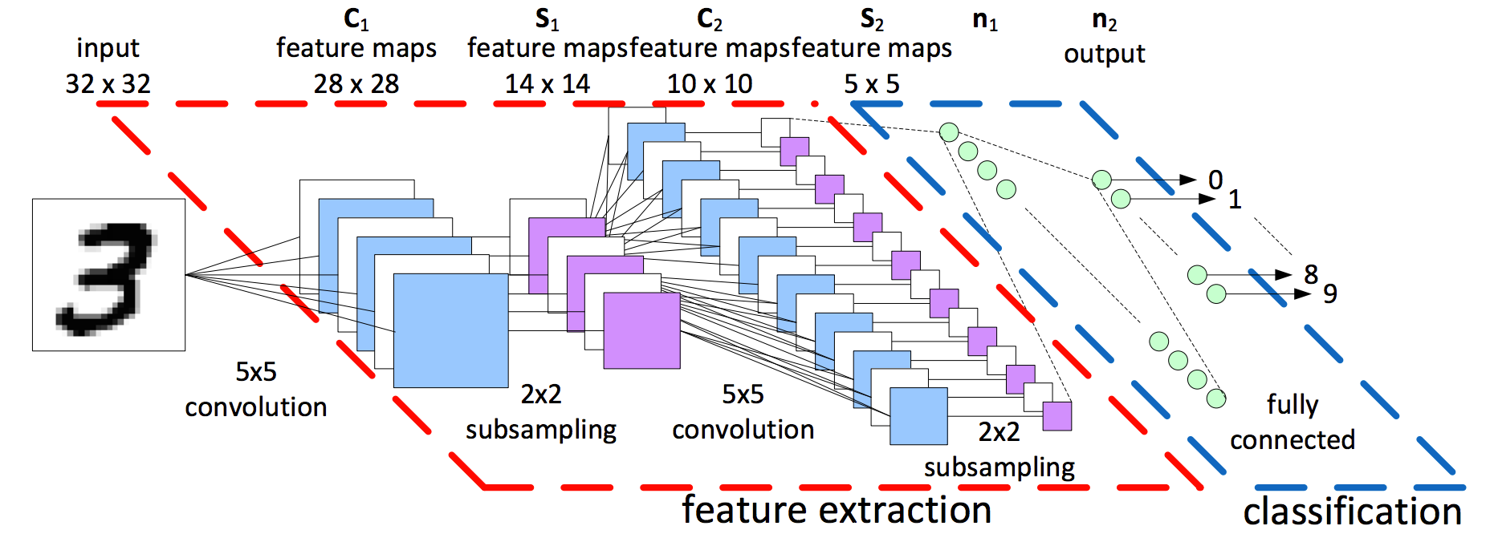
4.How to train and test your model
Tensor & Flow
In Tensorflow1 we use static graph
In Tensorflow2 we can still turn on a static graph with g = tf.compat.v1.Graph(), but this method is obsolete and we generally use the new features in Tensorflow2 - eager execution and autograph
Data is Tensor
Data(Tensor) Flow in a computational graph and finalize the result of the computation
Notes:
In TensorFlow, all data can be understood as Tensors, which are vectors. Any data can be a vector; for example, the digits in the MNIST dataset we are working with are a form of vector.
In the early days of TensorFlow, as you might have seen in the reference book, people used static graphs to construct the model training process. However, this method has become outdated over time. Now, most people use TensorFlow 2's new feature, eager execution, to allow the program to autonomously construct the computation graph. Alternatively, you can use the more advanced AutoGraph to achieve the effects of static graphs.
在Tensorflow中一切的数据都可以被理解为Tensor,也就是向量，任何数据都可以是向量，比如我们所看到的MNIST数据集中的数字便是一种向量，向量
在tensorflow的早期如同你在参考书中看到的那样，人们使用静态图来构建模型的训练过程，然而这种方式已经随着时间的流逝被淘汰了，现在绝大多数人们使用tensorflow2的新特性急切执行来交由程序自主构建运算图，或者你可以使用更加先进的自动图来实现静态图的效果。

Slide 10

4.How to train and test your model
Code train step
@tf.function(input_signature=[tf.TensorSpec(shape=[None, 784], dtype=tf.float32), tf.TensorSpec(shape=[None, 10], dtype=tf.float32)]) def train_step(data, label): with tf.GradientTape() as tape: logits = my_model(data) loss = loss_fn(label, logits) gradients = tape.gradient(loss, my_model.trainable_variables) optimizer.apply_gradients(zip(gradients, my_model.trainable_variables)) return loss
This tape works as
gradients and automatic differentiation
CACULATE AND RECORD
Notes:
In this slide, I provided an example of using decorators to create an AutoGraph. The `@tf.function` decorator can be used to convert a regular Python function into an AutoGraph, speeding up the model training process. Here, I have specified the input size of the model to mimic the placeholders mentioned in the book.
Additionally, I have used `tf.GradientTape` to record the gradient propagation and propagate the loss back to the parameters during backpropagation, thereby optimizing the model. Its working principle is just like its name suggests: a tape, used for recording and backtracking. This is the core part of AutoGraph and even the entire TensorFlow framework.
在这张幻灯片中，我举了一个使用装饰器创建自动图的例子，@tf.function这个装饰器可以用来将一个普通的python函数转换为一个自动图，加快模型的训练速度，在这里我限定了模型的输入size用来模仿书中的placeholder。除此之外我还用到了tf.GradientType来记录梯度的传播，并且在反向传播过程中将损失传播回各个参数，从而起到优化模型的作用，它的工作方式就像它的名字一样：磁带，用来记录和回溯，这是自动图甚至整个tensorflow的核心部分。

Slide 11
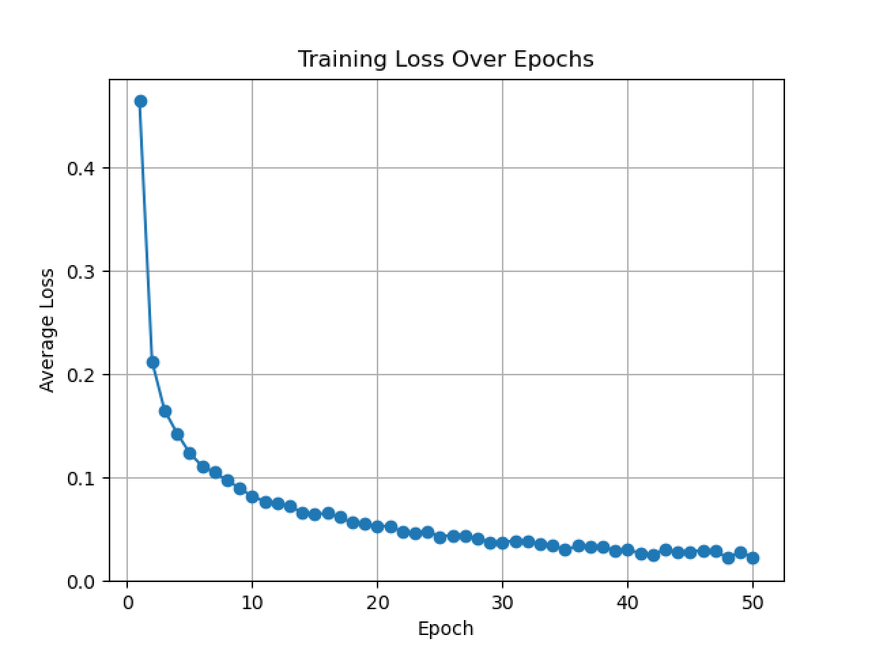
4.How to train and test your model
for epoch in range(50): batch_generator = data.create_batch_generator(images, labels, shuffle=True) batch_training_losses = [] for batch_x, batch_y in batch_generator: loss = train_step(batch_x, batch_y) batch_training_losses.append(loss) avg_loss = sum(batch_training_losses)/len(batch_training_losses) if avg_loss < best_loss: best_loss = avg_loss my_model.save(best_model_path) print(f"Epoch {epoch + 1}, Average Loss: {avg_loss}")
Notes:
Next, we begin training. Like in the book, we will train for 50 epochs, but I've made some improvements. Instead of using SGD as in the book, I've opted for the Adam optimizer to accelerate convergence. This typically means faster training. Additionally, I save the model with the lowest average loss, which will be used later in the testing phase.
Because the model is straightforward, training speed is very fast. You can even train it live. After training, you will see the trend of loss decreasing, gradually approaching 0, indicating that the model is converging. We can now proceed to testing the model.
下面我们开始训练，如同书中一样我们进行50轮训练，但我做了一些改进，我采用了Adam优化器来加速收敛而不是书中的SGD，这通常会意味着更快的训练速度，同时我还将平均loss最低的模型保存下来，这个保存下来的模型会在之后的测试环节中用到。因为模型很简单训练速度非常的快，你甚至可以现场训练它，完成训练后你会看到loss的变化趋势，逐渐趋近于0，这意味着模型逐步收敛，我们可以开始测试模型了。

Slide 12

4.How to train and test your model
Finally, Let’s test our model!!!
You can find the test images I prepared in img_sample, which were hand-drawn by me and have different colors to simulate the actual situation.
Of course, if you want to test your own handwritten numbers, that's perfectly fine, but keep one thing in mind, because the image will be resized to 28x28 which means that your image aspect ratio should be close to 1, please pay attention to this or your image will be distorted during the resizing process!

Slide 13
4.How to train and test your model
Let’s see how these pictures be processed
Do you remember?
def preprocess_image(image_path): img = cv2.imread(image_path) img = cv2.resize(img, (28, 28)) img = cv2.cvtColor(img, cv2.COLOR_BGR2GRAY) img = cv2.bitwise_not(img) img_flatten = img.flatten() img_ready = ((img_flatten / 255.) - 0.5) * 2 img_ready = np.expand_dims(img_ready, axis=0) return img_ready
Step1:Unpack the dataset and read the images and tags respectively
Step2:Use numpy to flatten the 28x28 image to 1x784.
Step3: images = ((images / 255.) - .5) * 2 maps the grayscale data from 0-255 in the image to the interval -1 to 1
Notes:
Here, I'd like to emphasize that the way images are processed during testing should be consistent with training to ensure that the model can make accurate predictions. Earlier, I mentioned that I removed the regularization part. The purpose was to maintain consistency in the data range during training. Homemade datasets often come with backgrounds that can affect overall brightness. Therefore, the normalization followed by regularization method in the book would cause data shifting. A better approach is to apply regularization before normalization. This way, it can offset variations in brightness without affecting predictions.
这里我想强调一点，这里读取图像的处理方式应该与训练时保持一致，这样模型才能正常预测。之前我提到了我删除了正则化的部分，目的就是为了在训练的时候数据的范围保持一致，因为自制数据集带有背景，会影响整体亮度因此书中先归一化再正则的方法会导致数据发生偏移，一个比较好的解决方法是先正则化再归一化，这样能够在抵消明暗变化的时候不影响预测。

Slide 14
4.How to train and test your model
Start test
if __name__ == '__main__': img_path = "img_sample/8.png" # reload the model trained_model = tf.keras.models.load_model(filepath="record/my_best_model.keras") # preprocess the test image processed_image = preprocess_image(img_path) result = trained_model.predict(processed_image) # analysis the result predicted_label = np.argmax(result, axis=1)[0] confidence = np.max(result, axis=1)[0] print(f"result: {predicted_label}") print(f"prob: {confidence:.4f}")
Notes:
By modifying img_path, you can specify the image for the model to predict. Here, we'll use the digit 8 as an example. We'll load the best results from our previous training here and obtain the predicted label and confidence level.
通过修改img_path你可以指定输入模型进行预测的图片，我们这里用数字8来举例。在这里加载我们之前训练的最佳结果并得到预测标签和置信度。

Slide 15

4.How to train and test your model
The road ahead is long and far-reaching
4 or 9?
I did output the confidence levels for all 0 through 9 using breakpoint debugging, and as you can see, the model thinks that the number 4 has a high probability of being 9 a very low probability of being 1. While the confidence levels are much lower than the results for the other numbers, the two possible outcomes are still wrong.
The full confidence levels are as follows
Notes:
There is still significant room for improvement in our model. In an ideal scenario, the confidence level for the predicted label should be very close to 1, while the confidence levels for other labels should approach 0, as seen in our one-hot encoding results. In the model I provided, it fails to correctly predict the digit 4; instead, it misclassifies 4 as 9. While 4 and 9 do share high similarity in their images, from the model's perspective, this misclassification indicates that there's still work to be done to improve its accuracy and robustness.
我们的模型仍然有非常大的改进空间，一个理想的模型进行预测时置信度应该极其接近1，其他标签的置信度应该无限接近于0，正如我们的one_hot编码中所看到的结果那样。在我给出的模型中，无法正确的预测数字4，模型会把4误认为是9。4和9在图像上看确实有很高的相似度，但从模型的角度讲，很难说这是一个好的模型。

Slide 16
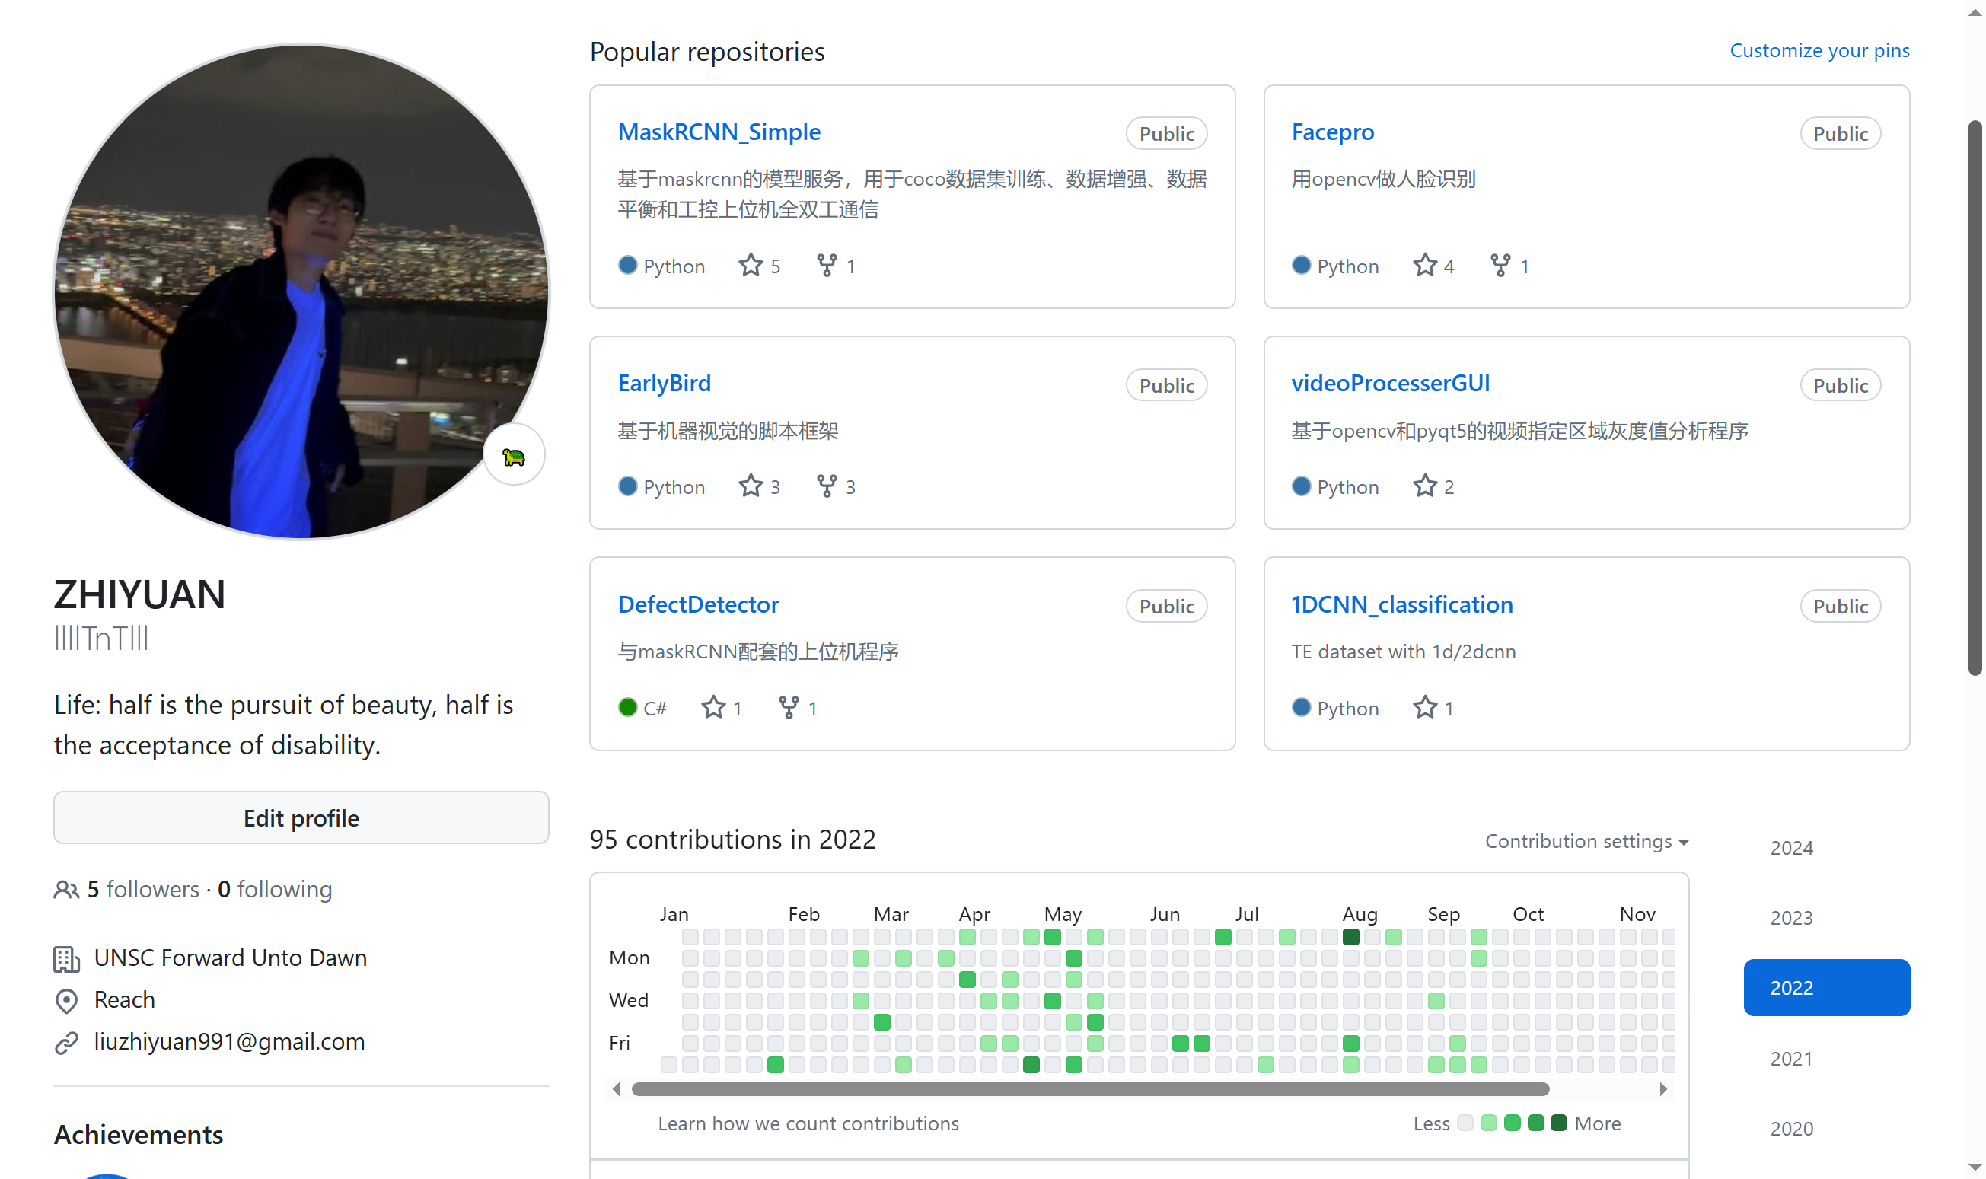
More
Come to my Github to see more
You can download all the material from this publication in my repository:
llllTnTlll/MNIST_Tensorflow (github.com)
About three years ago I had built a complete MNIST recognition network using the latest tensorflow 2.0, which is much better and has cleaner code, you can get it at the following repository address:
machineLearning/Checkpoint/MNIST_withCheckpoint.py at master · llllTnTlll/machineLearning (github.com)
https://github.com/llllTnTlll
Notes:
ue to time constraints, I won't be able to delve into all the details of neural network training today. If you're interested in learning more about deep learning and addressing issues like the confusion between 4 and 9, you're welcome to visit my GitHub page. You'll find complete code I wrote a few years ago in the two repositories mentioned on the right side. This code is more concise, uses the Model class-based approach to building models, and has a more reasonable structure. It achieves an accuracy of around 99%. Feel free to reach out to me if you have any questions or would like to discuss further.
受限于时间，我今天没办法为大家讲解神经网络训练的全部细节，如果你想了解更多关于深度学习的知识，比如解决之前4和9的混淆问题。你可以来到我的github主页，你可以在右侧提到的两个仓库里找到我数年前写的完整代码，这份代码更加的简洁，使用了基于Model类的方式搭建模型，并且结构更加合理，能够做到百分之99的正确率，如果你有任何问题可以来与我交流。

